Slide 1
Introduction to Air Pollution
Presented by
Dr. Yu-Chieh Ting
Notes:
VOC and VOC-induced O3健康危害
太陽光跟VOC削減的關係

Slide 2
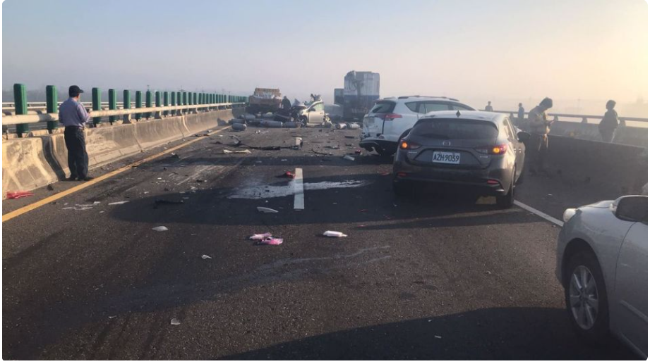
Text and references for this course
Fundamentals of Air Pollution, 5th Edition. Daniel Vallero
Case studies.
空氣污染防治 – 理論及設計
Grading
Homework: 40%.
Midterm and final exams: 60%.

Slide 3
Outline
Foundations of Air Pollution
The Risks of Air Pollution
Tropospheric Pollution
Biogeochemistry of Air Pollutants
Addressing Air Pollution
The Future for Air Pollution Science and Engineering
Notes:
Intro; Air pollution in the atmosphere; Gases and particulate matter; Monitoring techniques; VOC and HAPs; Greenhouse gases; Indoor air

Slide 4
The State of the Atmosphere - Introduction
The air pollution events have often been associated with dramatic atmospheric visuals, such as smoke billowing from industrial stacks into the air, smog hanging over large cities, dead trees from acid rain, and disasters with plume of contaminants reaching upward and outward into the troposphere, the lowest atmosphere layer where humans and other organisms reside.
Increasing levels of greenhouse gases in the troposphere; so-called “hole” in the ozone layer higher up in atmosphere (stratosphere).

Slide 5
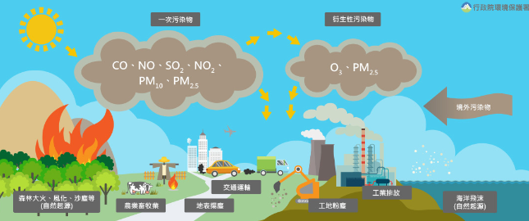
來自行政院環境保護署

Slide 6
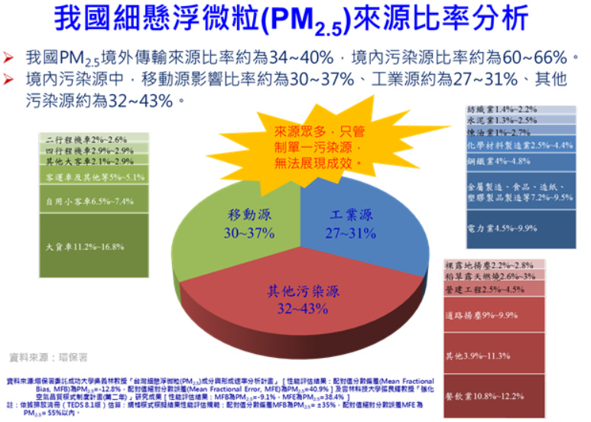

Slide 7
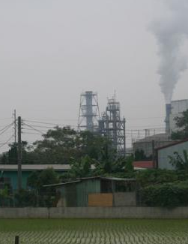
2008年大發工業區空氣污染事件
事件導致附近潮寮國中小近百名師生送醫就治，嚴重者全身抽搐、嘔吐，住院超過二個禮拜，症狀輕者終日昏沈，欠缺食慾。
潮寮事件堪稱台灣環境公害史上，最嚴重的毒災事件之一。
榮工公司大發廢棄物處理廠、長春樹脂、聯仕電子、台灣史都特、聯合污水處理廠。
「溴甲烷」、「1，2-二氯丙烷」、「反-1，3-二氯丙烯」、「六氯-1，3-丁二烯」四個污染物並未出現在上述五家工廠廢氣指紋中，距離潮寮國中四百公尺的空桶清洗廠「春春實業」，及距離一千兩百公尺的農藥空瓶清洗廠「瑞曼迪斯公司」，極有可能因傾倒盛有六氯-1，3-丁二烯的桶中殘餘廢液，造成短暫高濃度氣體排放，幾乎可確定是最大疑凶。

Slide 8
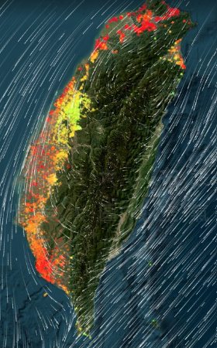
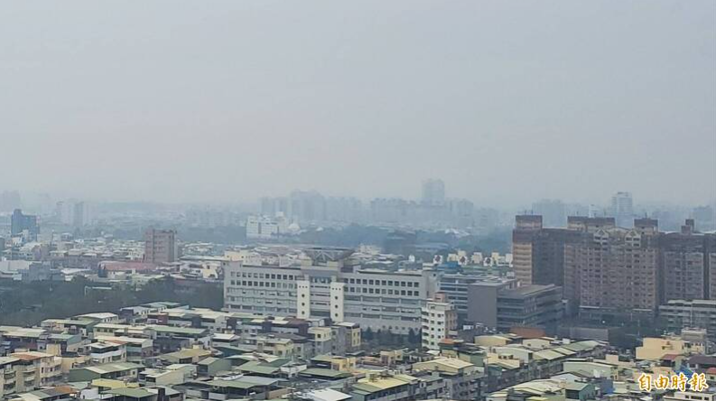
2023/02/20高雄上午空品惡化，鳳山等3測站亮紅燈。

Slide 9
The State of the Atmosphere – Physical and chemical properties of the atmosphere
99.99% of the atmosphere consists of four gases, molecular nitrogen and oxygen (N₂ and O₂), argon (Ar) and carbon dioxide (CO₂).
Ar is inert (nonreactive) since it is a noble gas; the other three compounds are also very stable and nonreactive under most atmospheric conditions of temperature and pressure.
Approximately 99% of the mass of the atmosphere lies within 50 km of the earth’s surface, i.e. in the troposphere and stratosphere, where the air pollution occurs.

Slide 10
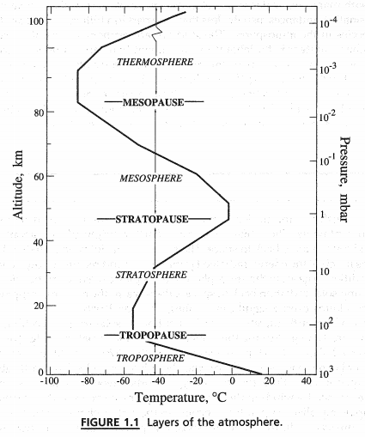
The earth’s atmospheric temperature varies with altitude.
The earth is warmed when incoming solar radiation is absorbed at or near the earth’s surface and reradiated at longer electromagnetic wavelengths (infrared).
The air grows progressively less dense with increasing altitude moving upward from the troposphere through the stratosphere and the chemosphere to the ionosphere.

Slide 11
Stratosphere, absorption and scattering of solar energy occur; the lower portion contains the stratospheric ozone layer, which absorbs harmful ultraviolet (UV) solar radiation. Long-term accumulation of chlorofluorocarbons (CFCs) and other gases released at the earth’s surface or by high-altitude aircraft affect this layer.
Troposphere, which we live and is the primary focus of this course; however, stratospheric ozone formation and destruction in some detail will be also discussed.

Slide 12
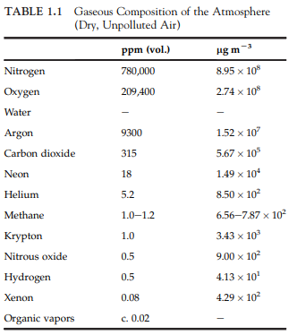
Tropospheric Composition
“Unpolluted” air in the troposphere means the composition of the air without human influence.
Other constituents, water vapor and other vapors (e.g. organic liquids), as well as liquid and solid phase constituents (aerosols or particulate matter (PM) held in suspension).
Air pollution terminology generally breaks matter down into two phases, particulate and gas.
Particulates and aerosols are generally synonymous terms in air pollution literature, i.e. liquid and solid phase. They are distinguished from gases and vapors.

Slide 13
Thermodynamic systems are classified into two major types: closed and open. A closed system does not allow material to enter or leave the system (refer to “control mass”); a open system allows material to enter and leave the systems (known as “control volume”).
Another thermodynamic concept is that of the “property”. An intensive property is independent of the system’s mass (such as pressure and temperature). An extensive property is proportional to the mass of the system (such as density or volume). Dividing the value of an extensive property by the system’s mass gives a “specific property”, such as specific heat, specific volume, or specific gravity.

Slide 14
The thermodynamic term for the description of the change of a system from one stage (e.g. equilibrium) to another is known as a “process”.
Processes may be reversible or irreversible; they may be adiabatic (no gain or loss of heat, so all energy transfers occur through work interactions) or non-adiabatic (will be introduced in the following chapters).
Other processes include isometric (constant volume), isothermal (constant temperature), isobaric (constant pressure), isentropic (constant entropy), and isenthalpic (constant enthalpy).

Slide 15
Phases partitioning means the substance will exist in one or more physical phases. An important partitioning coefficient for air pollution is Henry’s Law, which states that the partial pressure of a compound can be related to its equilibrium concentration in a dilute aqueous solution through a constant of proportionality.
A varying number of molecules will find their way into the air, even though most of the molecules remain in the water, i.e. dissolved in water. Even a small amount of partitioning can account for large amounts of vapor phase compounds in the atmosphere.
e^{p} = e^{kc}
e ≈2.71828; p:溶液上的氣體分壓(partial pressure)
C: 溶液體積莫耳濃度; k: Henry constant (因溶劑和溫度的不同而感變)

Slide 16
The predominant vapor in the air is, not surprisingly, water vapor.
In the atmosphere, above their temperature of condensation, vapor molecules act just like permanent gas molecules in the air; below its condensation temperature, if the air is saturated, water changes from vapor to liquid.
This phenomenon gives rise to fog or mist in the air and condensed liquid water on cool surfaces exposed to air.
Gaseous composition in Tables 1.1 is expressed as parts per million by volume - ppm (vol.) or ppmV.

Slide 17
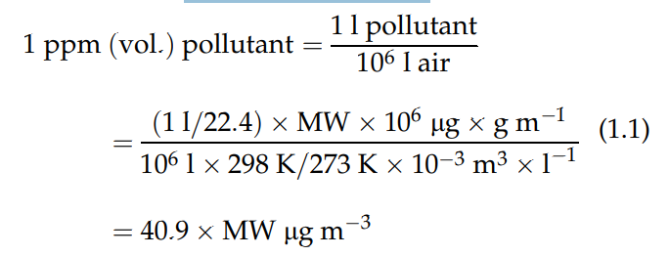
To convert from units of ppm (vol.) to µg m⁻³ , it is assumed that the ideal gas law is accurate under ambient conditions. A generalized formula for the conversion at 25 °C and 760 mmHg is:
Where MW equals molecular weight (g mol⁻¹).
For convenience, conversion units for common pollutants are shown in Table 1.3 (next slide)

Slide 18
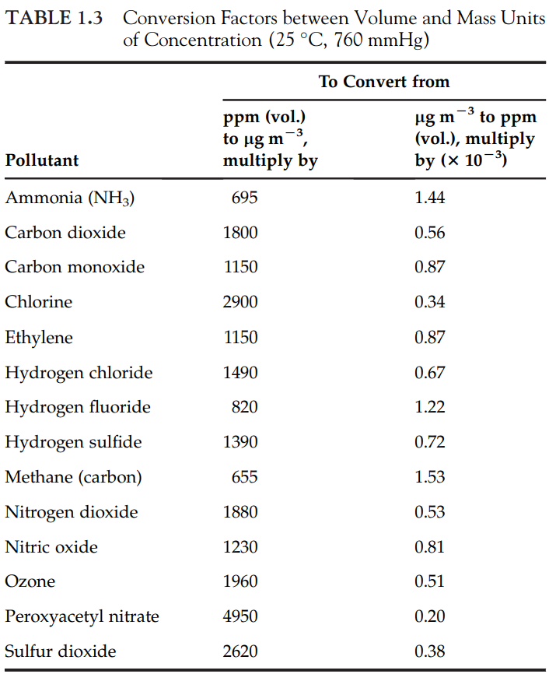

Slide 19
The State of the Atmosphere – Atmospheric Chemical Concentrations
Molecular nitrogen (N₂), molecular oxygen (O₂), water (H₂O), argon (Ar), and carbon dioxide (CO₂) make up most of the atmosphere.
Most other compounds and substances exist only in trace amounts.
Hydrogen is highly reactive, but exists only in trace amounts in the lower troposphere.
It should be noted from a mass balance perspective that nitrogen (N) and oxygen (O) exist in numerous chemical compounds in the atmosphere.
Photosynthesis provides most of the atmospheric O₂, predominant from terrestrial plants and aquatic microbes, especially phytoplankton (next slide)

Slide 20
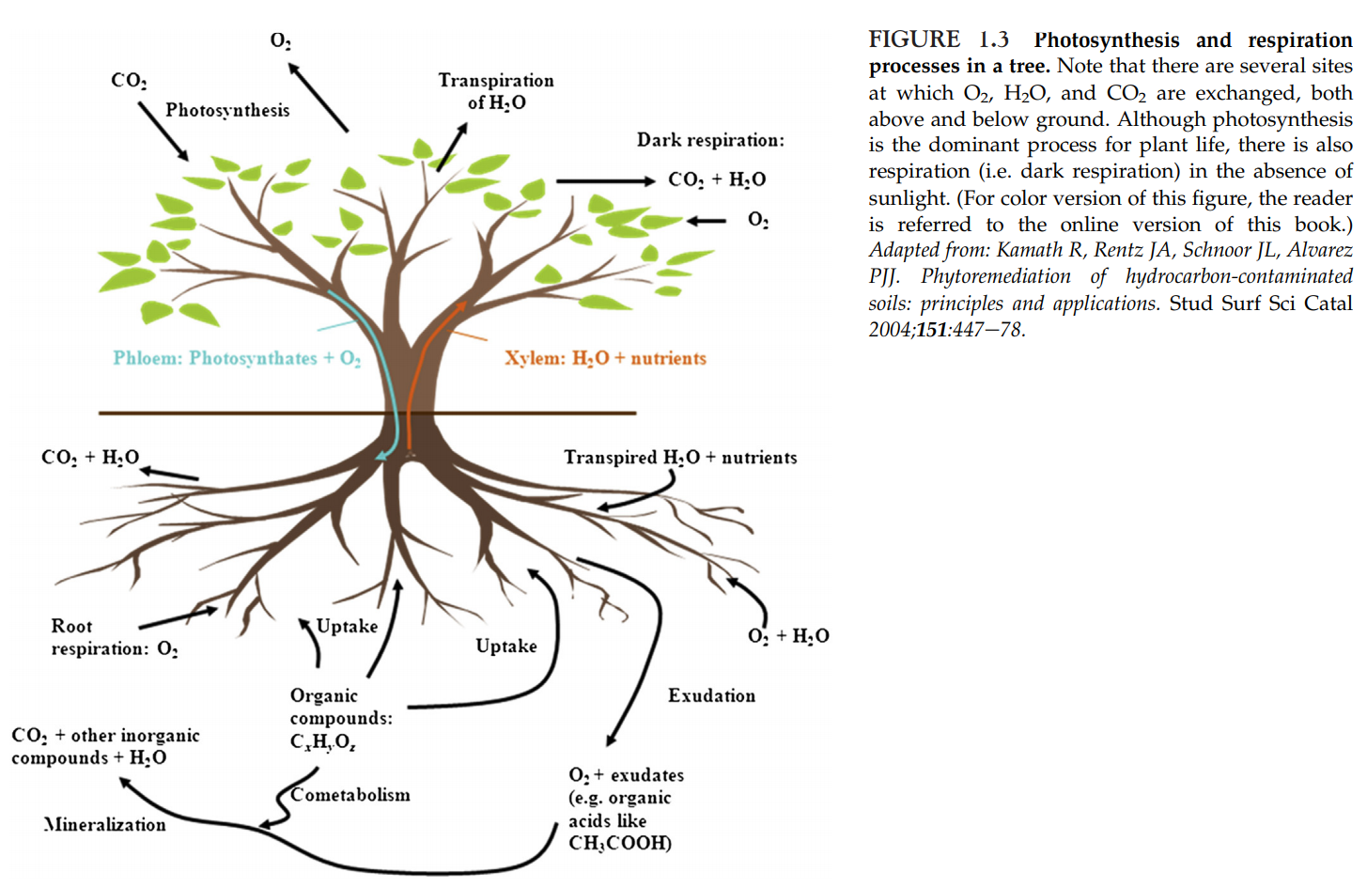

Slide 21
Using light energy from incoming solar radiation, photosynthesis converts vapor phase CO₂ and water into solid phase carbohydrates and O₂. Although there are numerous intermediate steps, the reaction is summarized as:
In the upper altitudes, water vapor and N₂O undergo photodissociation via UV solar radiation, additional O₂ is formed providing between 1 and 2 percent of atmospheric oxygen.
Carbon (C) is the distinguishing element for organic compounds, i.e. those with C-C and/or H-C bonds, but it is also part of many inorganic compounds, including CO₂ and carbon monoxide (CO).
Carbon is a major constituent of many air pollutants, including CO, PM in various forms, as well as many of the most toxic air pollutants, e.g. dioxins, polychlorinated biphenyls (PCBs), and many pesticides.

Slide 22

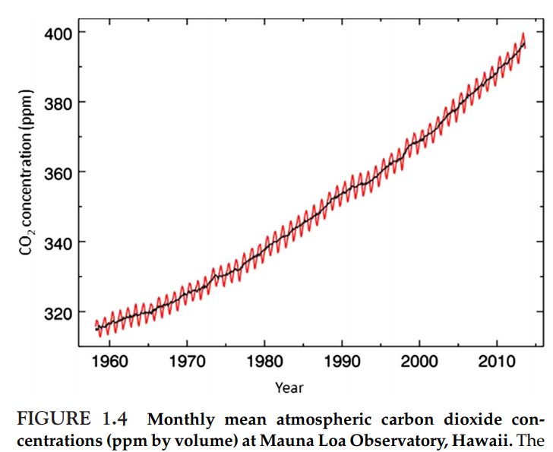
Recent interest are greenhouse gases, of which, most are carbon compounds, e.g. CO₂, CH₄, and chlorofluorocarbons (HCHs). Thus, C, O, N, and H are the principal elements involved in air pollution.
Several of the abundant compounds in the atmosphere are greenhouse gases, most notably CO₂, CH₄, and N₂O.
As the most abundant greenhouse gas, CO₂ has been the focus of much recent interest in both scientific communities and the public at large. The amount has steadily increased in recent decades.

Slide 23
Methane (CH₄), the most abundant organic molecule in the atmosphere, also increased in concentration dramatically after the industrial revolution, but is no longer increasing.
It is produced from anaerobic processes. These include agriculture, e.g. livestock and rice paddies; landfills; fossil fuel extraction and gas distribution; and biomass burning.
These anthropogenic sources produce about the same amounts of CH₄ as natural sources, which include reduced, anoxic portions of wetlands and portions of ecosystems undergoing organic decomposition.
CH₄ is a much more potent greenhouse gas than CO₂, absorbing 22 times energy per unit mass. However, at about nine years, its atmospheric residence could be far less than that of CO₂, which is estimated to range between 5 and 100 years (Table 1.4 on next slide).

Slide 24
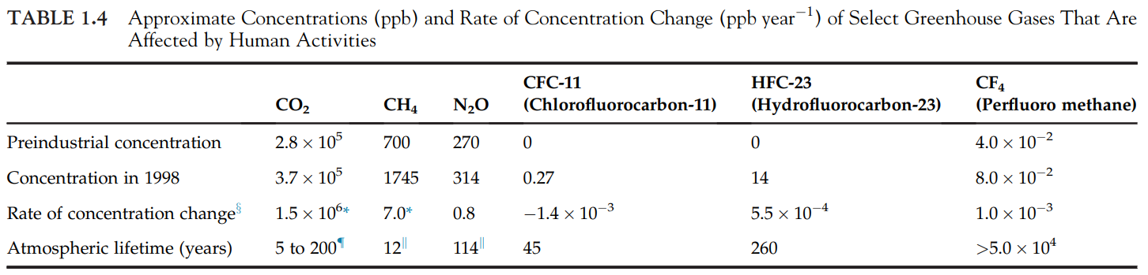
More than 90% of the degradation of methane is by oxidation, mainly by reactions with the hydroxyl radical in the stratosphere which accounts for more than 90% of methane loss. The equilibria and fate of CO₂, CH₄, and other carbon compounds are discussed in detail in the following chapters.
Essential compounds include micronutrients needed by plant life and other organisms in the ecosystems. However, even essential substances can become pollutants in the wrong concentrations. Thus, expression of chemical concentration is crucial to understanding atmospheric science generally and the fundamentals of air pollution specifically.

Slide 25
Chemical Concentration
Atmospheric concentrations can be expressed as combinations of mass and volume, usually volume per volume or mass per volume.
The higher the vapor pressure of a substance, the more of the molecules of that substance finds its way to the atmosphere. This exchange among solid, liquid, and gas phases, including vaporization, is discussed in detail in the following chapters.
Atmospheric concentrations can be both spatial and temporal variability, such as the differences in ambient concentrations in various urban areas and seasonal differences in the same urban area.

Slide 26
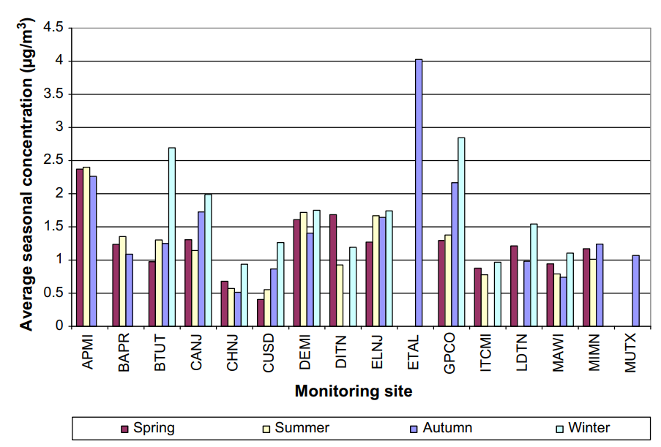
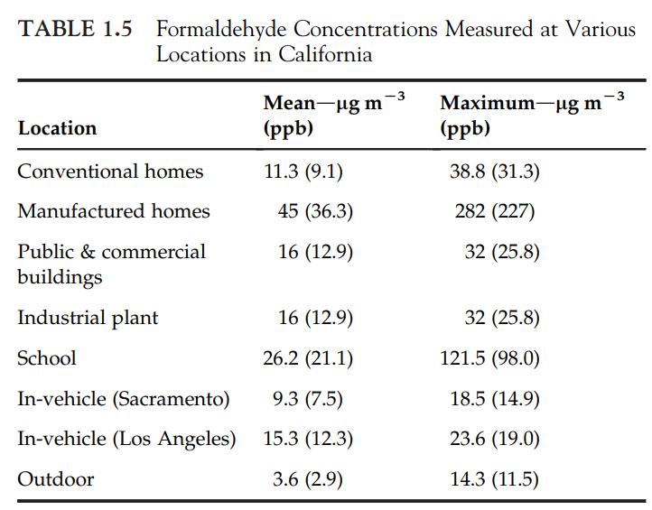
FIGURE 1.6 Measured concentrations of formaldehyde in several urban areas during four seasons of the year 2005.

Slide 27
Although the total amount of substances under the category “organic vapors” is somewhat constant on a global atmospheric scale, it is highly variable in the ambient air (e.g. much higher concentrations near a wood processing facility) and even more variable between ambient and indoor air, as indicated in Table 1.5.
The variability in chemical concentrations can be even greater among various types of indoor environments.
The concentration of an air pollutant that is expected and permitted will vary according to the protection needed in ambient air and various personal and workplace microenvironments

Slide 28
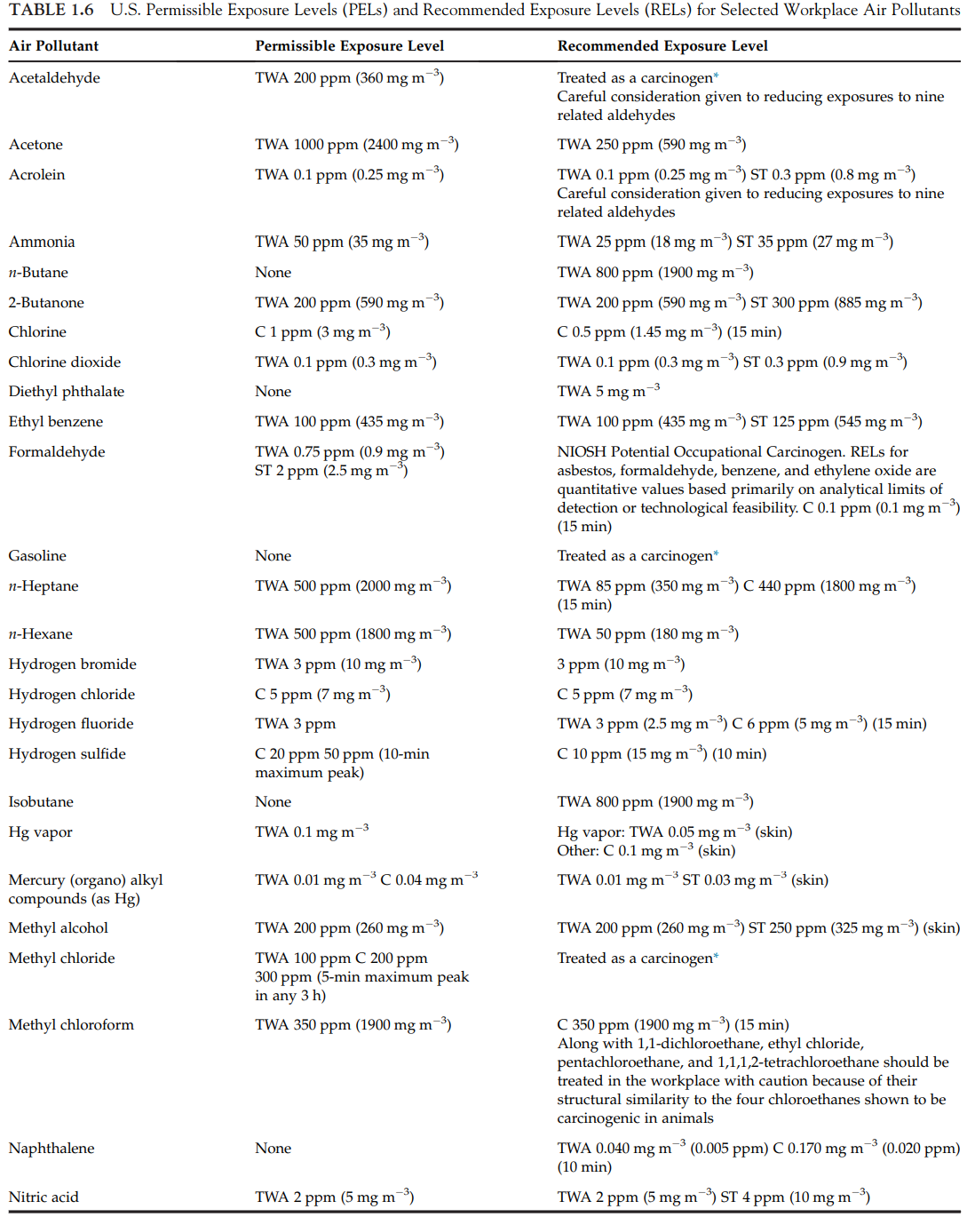
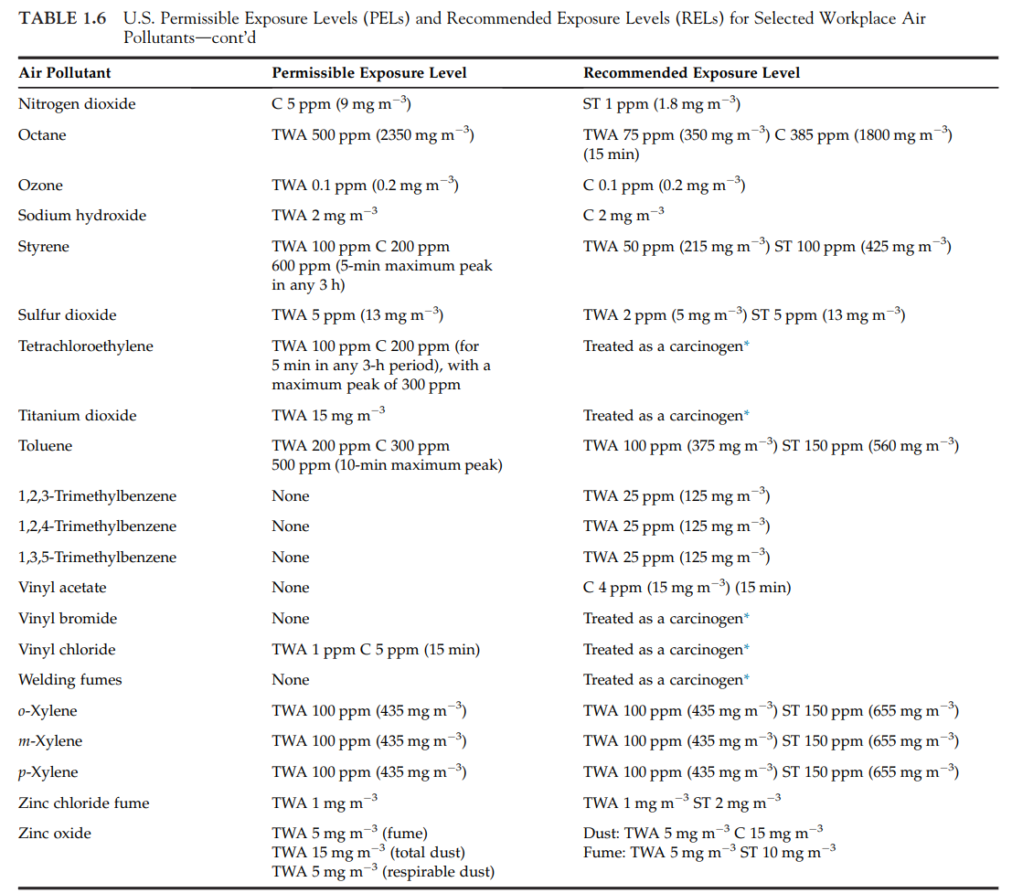

Slide 29
The State of the Atmosphere – Fluid Properties and Dynamics
Air is the most prominent fluid when considering air pollutants, but it is not the only fluid involved in air pollution.
Water is arguably equally important for numerous reasons, including as a component of the atmosphere and as the transport and transformation medium of bodily fluids during intake, adsorption, metabolism, distribution, and excretion of air pollutants and their byproducts within an organism.
Indeed, the pollutants themselves are often fluids under environmental conditions, e.g. alcohols, solvents, and oils.

Slide 30
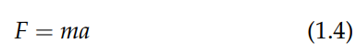
The first law of motion states that every object in a state of uniform motion tends to remain in that state of motion unless an external force is applied to it, i.e. inertia.
The most common external force that changes the state of uniform motion is friction.
The second law of motion describes the relationship between an object’s mass m, its acceleration a, and the applied force F:
Acceleration and force are vectors; wherein the direction of the force vector is the same as the direction of the acceleration vector.
If the mass of the pollutant, the mass of the fluid where it resides (i.e. air mass), and applied force (e.g. generated by the wind) are known, then the acceleration of a particle can be calculated, as well as the acceleration of the entire plume from one point to another.

Slide 31
The third law of motion states that for every action there is an equal and opposite reaction.
Movements are dynamic and actions taken to change the velocity or direction of a pollutant (e.g. baffles, vents, and barriers) will be met with resistance and will result in changes in flow and direction of the pollutants. This comes into play when designing pollution control equipment.
There are numerous ways to identify, characterize, and analyze air pollution and to determine how the exposure to a pollutant has led and can lead to health and environmental impacts.

Slide 32
Atmospheric Fluid Properties
The term “fluid” includes all liquids and gases.
A liquid is a form of matter that is composed of molecules that move freely among themselves without separating from each other.
A gas is a form of matter that is composed of molecules that move freely and are infinitely able to occupy the space in which they are contained at a constant temperature.
The medium itself, gases like carbon monoxide, vapors like benzene, and liquid aerosols.
Water is a key fluid, such as its vapor phase (e.g. clouds, fog, and steam) and its liquid phase (e.g. droplets, surface and groundwater interactions with the atmosphere).

Slide 33
Fluid properties, along with fluid dynamics determine the extent and severity of a disaster.
Contaminant’s fluid properties will determine how soluble it will be in water droplets that are transported and deposited differently from air pollutants having lower aqueous solubility.
If a chemical is easily absorbed, the hazard may be higher.
The fluid properties of an agent, whether chemical or biological (e.g. bacteria and viruses), determine where the agent is likely to be found in the environment after release.

Slide 34
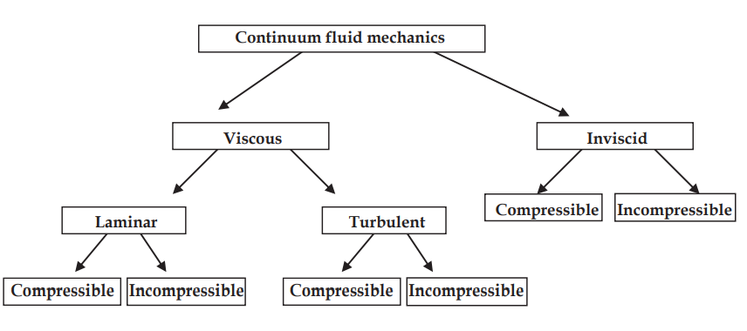
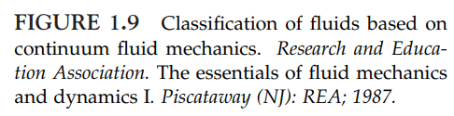
Fluids can be classified according to observable physical characteristics of flow fields.
A continuum fluids mechanics classification is shown in Figure 1.9.
Laminar flow is in layers, while turbulent flow has random movements of fluid particles in all directions.
In incompressible flow, the variations in density are assumed to be constant, while the compressible flow has density variations, which must be included in flow calculations.
Viscous flows must account for viscosity while inviscid flows assume viscosity is zero.

Slide 35
The time rate of change of a fluid particle’s position in space is the fluid velocity (V).
Speed (V) is the magnitude of the vector velocity V at any given point in the fluid, and average speed ṽ is the mean fluid speed through a control volume’s surface.
Velocity is a vector quantity (magnitude and direction), while speed is a scalar quantity (magnitude only). The standard units of velocity and speed are meter per second (m s⁻¹ ).
Velocity is important in determining pollution properties and mechanisms, such as mixing rates after an effluent is discharged to a stream, how rapidly an aquifer will become contaminated.

Slide 36
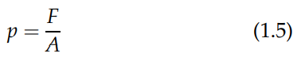
Another important fluid property is pressure. A force per unit area is pressure (p):
p is a type of stress that is exerted uniformly in all the directions.
The standard unit of p is the pascal (Pa), which is equal to 1 N m⁻² .

Slide 37
Potential and kinetic energy discussions must consider the fluid acceleration due to gravity.
Acceleration is the time rate of change in the velocity of a fluid particle: length per time per time (m s⁻² ).
In the countries, pollution rules, regulations, and standards are not used consistently and uniformly. For example, the regulations for ozone (O₃) are expressed volumetrically in parts per billion, but aerosols are usually mass per volume.
Since volume is directly proportional and temperature indirectly proportional to density (combined gas law), some assumptions must be made before converting volumetric units (ppm, volume) to concentration units (µg m⁻³ ).

Slide 38
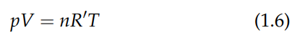
Unless otherwise stated, the first simplifying assumption is that the ideal gas law is expected to apply to environmental conditions:
Where n is the number of moles and R’ is the gas constant, R’=8.315 J K⁻¹ mol⁻¹.
An ideal gas is one in which the atoms or molecules are moving randomly and not interacting with one another.
Under environmental conditions, e.g. standard temperature and pressure, most gases in the atmosphere behave like ideal gases.
At decreasing temperatures and pressures, gases begin to deviate from ideal behavior, especially due to molecular size (i.e. less space between molecules means the ratio of molecule to void space increases) and intermolecular forces (i.e. the ratio of kinetic energy to intermolecular forces decreases)

Slide 39
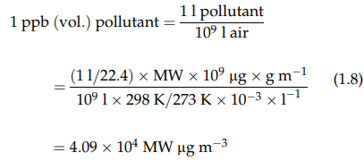
Since the density (ρ) of a fluid is its mass per unit volume (e.g. mg m⁻³ ), the density of an ideal gas is found using the gas constant specific to that molecule and applying the ideal gas law:
Where p = gas pressure; R = specific gas constant; T = absolute temperature.
The specific gas constant must be known to calculate the gas density. R for air is 287 J kg⁻¹ K⁻¹ ; The specific gas constant for methane (RCH₄) is 518 J kg⁻¹ K⁻¹ .
At these assumptions, at 25 ºC and 760 mmHg, ppb (vol.) can be converted to µg m⁻³ :
Where MW = molecular weight.

Slide 40
It is a common practice to add concentrations of nitrogen dioxide and nitric oxide in ppm (vol.) and express the sum as “oxides of nitrogen”. In metric units, conversion from ppm (vol.) to µg m⁻³ must be calculated separately for nitrogen dioxide and nitric oxide prior to addition.
Density is a very important fluid property for any air pollution situation.
If a pollutant is very dense, such as a heavy particle, it will stay aloft for a much shorter time and distance than will a lighter particle of the same shape and size.

Slide 41
The Science of Air Pollution- Air Pollution in perspective
Biologists may think of how contaminants in the air affect living things.
Ecologists are often interested in how exposures to air pollutants affect biodiversity and overall ecosystem health.
Biomedical scientists are concerned about the diseases associated with various air contaminants.
Toxicologists, in particular, are interested in how these effects differ from one species to another and from one type of contaminant to another.
It is not unusual for a compound to be acutely toxic at low doses for fish, but acutely toxic in mammals only at much higher doses.

Slide 42
Biological specialists have myriad concerns about air pollution, such as geneticists’ interest in how pollutants may change genetic material in organisms or how genetically modified organisms may be transported into the atmosphere and potentially reach human populations and ecosystems.
Epidemiologists are interested in how the exposure and effects of air pollutants differ in time and space.
Chemists are often concerned about the various types of pollutants. For example, they may be interested in how reactive or persistent certain compounds are after they are released from a stack, vent, or tailpipe.
How the compounds change after release, i.e. what reactions occur in the atmosphere after release.

Slide 43
This is also the concern of physicists, who want to explain the thermodynamics and motion that is involved in this transfer and the fate of air pollutants as they are created and after they are released.
People living near an industrial complex likely will see frequent, visible signs of pollution, such as dark plumes emitted from smoke stacks or hazy conditions on certain days.
A person with asthma may be more concerned about certain air pollutants than those who have never experienced breathing problems.
Students who have taken a few earth science or meteorology courses, hopefully, will be more aware of even subtle forms of pollution than are lesser informed people.

Slide 44
The U.S. Environmental Protection Agency (EPA) defines air pollution as the presence of contaminants or pollutant substances in the air that interfere with human health or welfare, or produce other harmful environmental effects.
Most pollutants cannot be sufficiently and accurately detected solely by the five human senses. Many are odorless, colorless, and otherwise undetectable.
Even those that are inherently detectable with unaided human senses, such as hydrogen sulfide’s (H₂S) rotten egg odor or orange color of lead oxide (PbO), are sensed only at concentrations well above thresholds of harm.
“what you don’t know won’t harm you” is not true for most air pollutants.

Slide 45
The Science of Air Pollution- Emergence of Air Pollution, Engineering, and Technology
Environmental awareness is certainly more “mainstream” and less a polarizing issue than it was in the 1970s, when key legislation reflected the new environmental ethos.
The 1970 Clean Air Act codified the national need to decrease air pollution by requiring federal standards for ambient air quality.
Not only are the environmental disciplines young, but also many of the environmental problems faced today differ from those throughout most of human history.

Slide 46
The Science of Air Pollution- What is Air Pollution
When does science consider the atmosphere to be unpolluted versus polluted?
To compare the condition of the atmosphere currently against some type of baseline, e.g. pre-industrialized atmosphere prior to the nineteenth century.
Another approach is to consider the principles by which materials are released into the atmosphere, move, transform, and are removed from the atmosphere, and based on this assessment determine the extent of atmospheric pollution.
The same chemical compounds or particles from a natural source (e.g. a volcano) elicit the same adverse effects as when they are emitted by anthropogenic sources.
Air pollution implies acceptability

Slide 47
Air pollutants affect both human health and ecosystems.
Approximately two million people in rural areas die each year from exposure to high concentrations of particulate matter (PM) suspended in the indoor air. Excess mortality due to outdoor PM and sulfur dioxide contribute to mortality of about 500,000 people annually.
In the United States, the Clean Air Act of 1970 established the National Ambient Air Quality Standards (NAAQS) to address six so-called “criteria air pollutants”: particulate matter (PM), ozone (O₃), carbon monoxide (CO), sulfur dioxide (SO₂), nitrogen dioxide (NO₂) and lead (Pb).
The clearest association of toxic air pollutants in recent decades has been with cancer, although neurotoxicity (especially in children) from lead and mercury grew in importance in the 1970s and 1980s. By the end of the twentieth century, new toxic pollutants also competed for the public’s attention, including air pollutants that threaten hormonal systems in humans and wildlife, as well as those associated with immune system disorders.

Slide 48
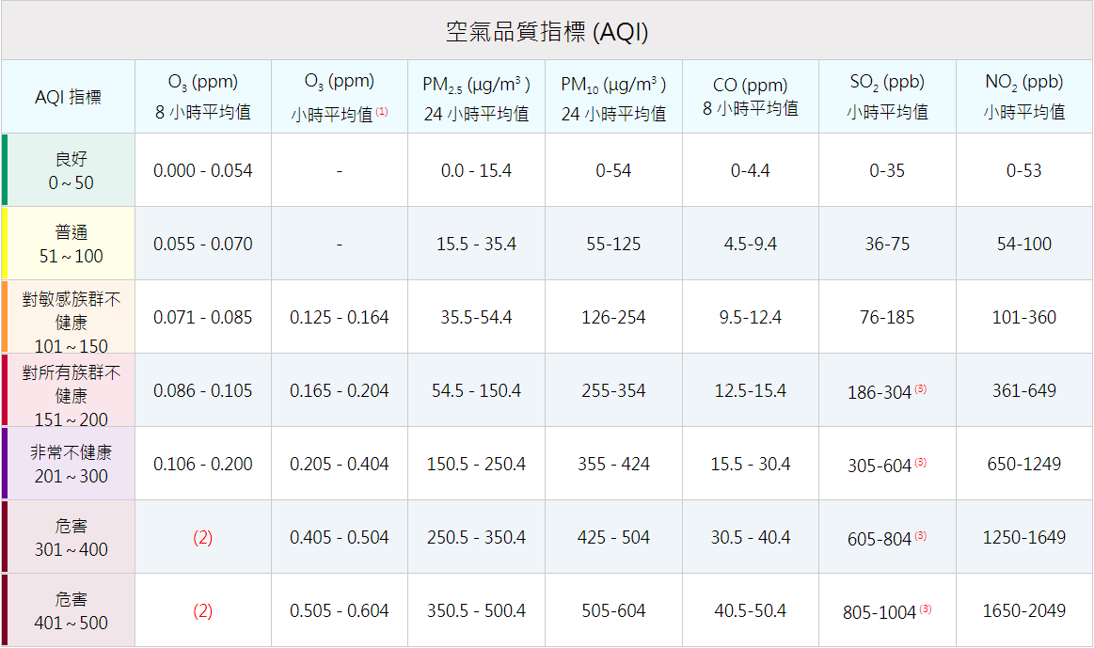
如O₃ 8小時值與1小時值皆有測，則皆計算AQI，取兩者之最大值作為AQI。
每小時監測數據更有預警性

Slide 49
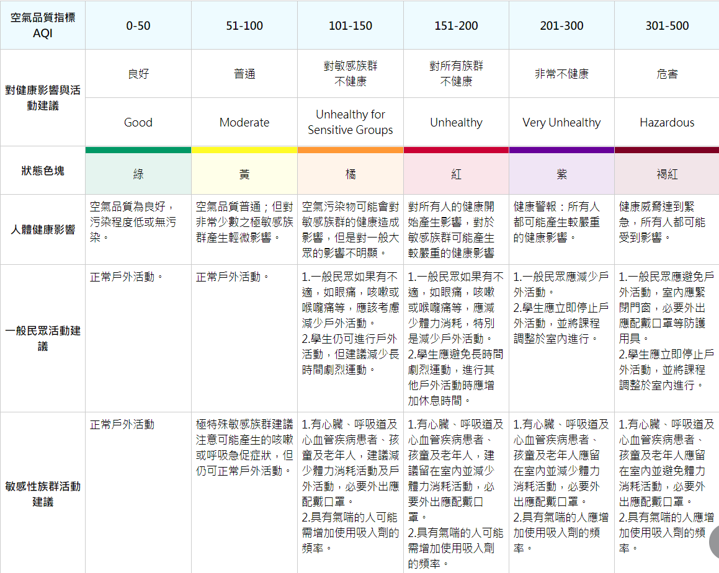

Slide 50
Particulate Matter
PM is always suspended in various concentrations in the troposphere.
Particles are aggregates of many molecules, sometimes of similar molecules, often of dissimilar ones. They form and transform in the air by several processes.
Some particles serve as nuclei upon which vapors condense. Some particles react chemically with atmospheric gases or vapors to form different compounds.
When two particles collide in the air, they tend to adhere to each other because of attractive surface forces, thereby forming progressively larger and larger particles by agglomeration.

Slide 51
The larger a particle becomes, the greater its weight and the greater its likelihood of falling to the ground (sedimentation) rather than remaining airborne.
Washout of particles by snowflakes, rain, hail, sleet, mist, or fog is a common form of agglomeration and sedimentation.
Other particles leave the air by impaction onto and retention by the solid surfaces of vegetation, soil, and buildings.
The particulate matter in the atmosphere is dynamic - continual injection into the air from sources of small particles; creation of particles in the air by vapor condensation or chemical reaction among gases and vapors; and removal of particles from the air by agglomeration, sedimentation, or impaction.

Slide 52
As mentioned earlier, the true natural background concentration will never be known. The best that can be done now is to assume that the particulate levels at remote places - the middle of the sea, the poles, and the mountaintops - approach the true background concentration.
PM is a common physical classification of particles found in the air, such as dust, dirt, soot, smoke, and liquid droplets.
PM is not a specific chemical entity but is a mixture of particles from different sources and of different sizes, compositions, and properties.
The chemical composition of PM is very important and highly variable, which can tell us much about its sources, e.g. receptor models use chemical composition and morphology of particles as a means to trace pollutants back to the source.

Slide 53
The chemical composition of tropospheric particles includes inorganic ions, metallic compounds, elemental carbon, organic compounds, and crustal substances (e.g. carbonates and compounds of alkali and rare earth elementals).
Some atmospheric particles can be hygroscopic, i.e. they contain particle-bound water.
The organic fraction can be particularly difficult to characterize, since it often contains thousands of organic compounds.
Particles range from ultrafine to coarse; the size of a particle is determined by how the particle is formed.

Slide 54
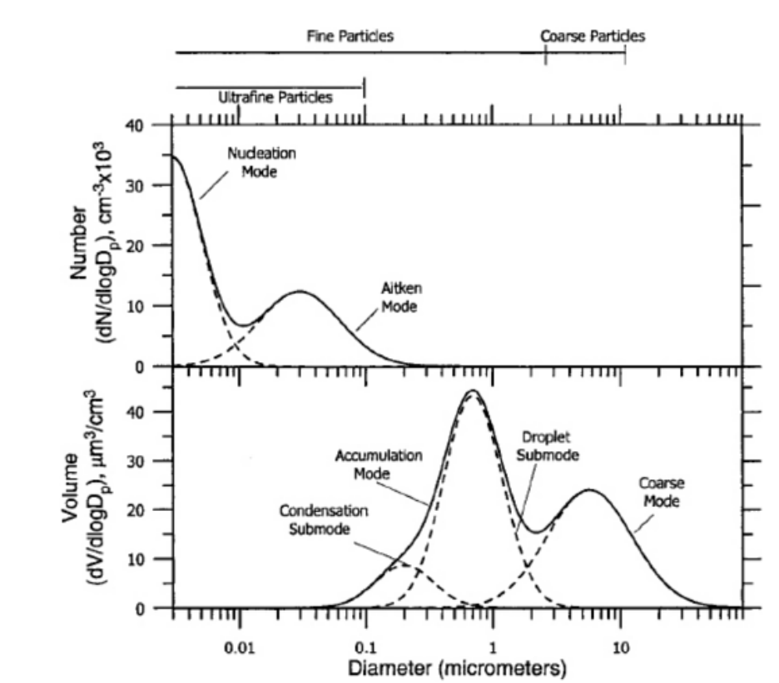

Slide 55
If particles are sufficiently small and of low mass, they can be suspended in the air for long periods of time.
Sources of particles are highly variable.
Particles may be emitted directly to the air from stationary sources, such as factories, power plants, and open burning, and from moving vehicles (known as “mobile sources”), first by direct emissions from internal combustion engines, but also when these and other particles are re-entrained due to the movement of vehicles (e.g. in a “near-road” situation)

Slide 56
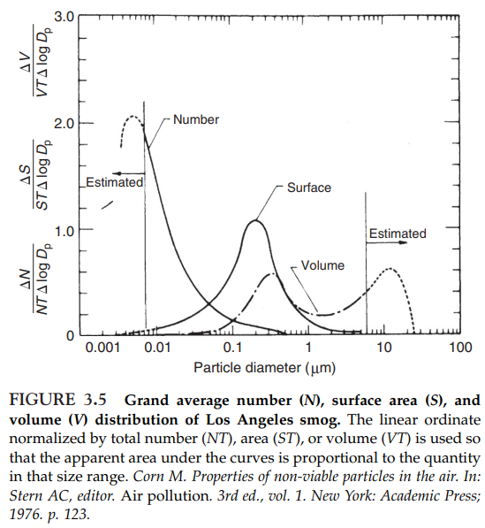
The volume (mass) distribution is called bimodal because of its separate maxima at about 0.2 and 10 µm, which result from different mechanisms of particle formation.
The mode with the 0.2-µm maximum results from coagulation and condensation formation mechanisms. They are called fine particles to differentiate them from the particles in the 10-µm maximum mode, which are called coarse.
These fine particles are primarily sulfates, nitrates, organics, ammonium, and lead compounds.

Slide 57
The mode with the 10-µm maximum are particles introduced to the atmosphere as solids from the surface of the earth and the seas, plus particles from the coagulation-condensation mode which have grown larger and moved across the trough between the modes into the larger size mode. These are primarily silicon, iron, aluminum, sea salt, and plant particles.
The majority of particles in the atmosphere are spherical in shape because they are formed by condensation or cooling processes or they contain core nuclei coated with liquid.
Other important particle shapes exist in the atmosphere; e.g. asbestos is present as long fibers and fly ash can be irregular in shape.
The amount of each element or radical, anion, or cation that is present in the mixture can be determined.
Specific organic compounds may be separated and identified.
The shapes of individual particles may be analyzed by electron microscopy.
Particle size dictates the necessary control technologies, determines the types of health and environmental problems to be expected when particles are inhaled and retained by the human respiratory system and when particles absorb and scatter incoming solar radiation.

Slide 58
The Science of Air Pollution- Atmospheric Transport and Fate
Air pollutants are studied from at least three perspectives: the sources, the movement, and the receptors.
The sources of air pollutants vary in size (e.g. tons emitted per year), type (e.g. stationary or mobile) and composition (e.g. coke oven emissions include thousands of compounds, but many smelters include a handful of metals).
Movement can range from molecular diffusion to continental and global transport in winds aloft.
Receptors include humans, ecosystems, and materials.

Slide 59
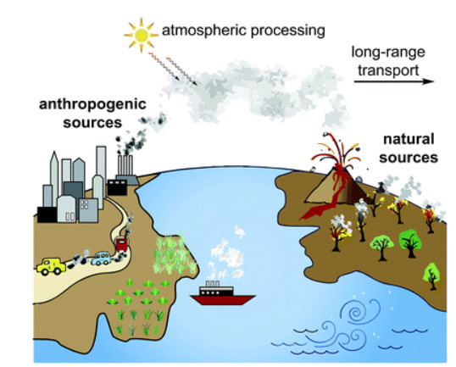
Reproduced from Nadine Borduas and Vivian S. Lin (2016)

Slide 60
Sources and Sinks
The places from which pollutants emanate are called sources.
There are natural as well as anthropogenic sources of the particles and gases considered to be pollutants.
Plant and animal respiration and the decay of what was once living matter; . Volcanoes and naturally caused forest fires are other natural sources.
A special type of natural sources are biogenic, which are living things that release a variety of pollutants, both organic (e.g. volatiles like pinene) and inorganic (e.g. carbon dioxide [CO₂] and methane [CH₄]).

Slide 61
The places to which pollutants disappear from the air are called sinks.
Sinks include the soil, vegetation, structures, and water bodies, particularly the oceans.
The mechanisms whereby pollutants are removed from the atmosphere are called scavenging mechanisms.
The measure used for the aging of a pollutant is its half-life - the time it takes for half of the quantity of a pollutant emanating from a source to disappear into its various sinks.
Most pollutants have a rather short half-life (i.e. days rather than decades) that prevents their accumulation in the air to the extent that they substantially alter the composition of unpolluted air.

Slide 62
Several gases do appear to be accumulating in the air to the extent that measurements have documented the increase in concentration from year to year. Such as CO₂, nitrous oxide (N₂O), CH₄, CFCs, and other halocarbons.
CFCs are chemically very stable compounds in the troposphere and have half-lives from tens of years to over hundreds of years.
One of the sinks for CFCs is transport to the stratosphere, where shortwave UV radiation photo-dissociates the molecules, releasing chlorine (Cl) atoms. When in excess, these Cl atoms decrease the steady state stratospheric ozone concentration, in turn increasing the penetration of harmful UV radiation to the earth’s surface.

Slide 63
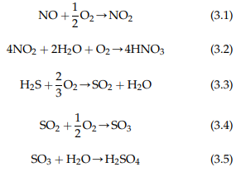
Oxidation, either atmospheric or biological, is a prime removal mechanism for inorganic as well as organic gases.
Inorganic gases, such as nitric oxide (NO), nitrogen dioxide (NO₂), hydrogen sulfide (H₂S), sulfur dioxide (SO₂), and sulfur trioxide (SO₃), may eventually form corresponding acids:
Oxidation of SO₂ is slow in a mixture of pure gases, but the rate is increased by light, NO₂, oxidants, and metallic oxides which act as catalysts for the reaction.
The formed acids can react with PM or ammonia to form salts, such as sulphate and nitrate.

Slide 64
Receptors
A receptor is something that is adversely affected by polluted air.
A receptor may be a person or animal that breathes the air and whose health may be adversely affected thereby, or whose tissue may be irritated, or whose surfaces (e.g. skin, leaf cover, roof) may be coated or discolored.
Some properties of the atmosphere itself, such as its ability to transmit radiant energy, may be affected.
Aquatic life in lakes and some soils are adversely affected by acidification via acidic deposition.

Slide 65
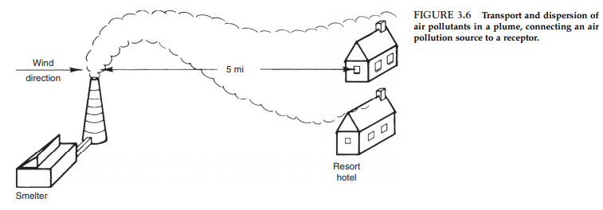
Transport and Dispersion
Transport is the mechanism that moves the pollution from a source to a receptor.
The wind is the means by which the pollution is transported from the source to the receptor.
During its transit over the 5 mile between the source and the receptor, the plume does not remain a cylindrical tube of pollution of the same diameter as the interior of the stack from which it was emitted.

Slide 66
If the wind speed is greater than the speed of ejection from the stack, the wind will stretch out the plume until the plume speed equals wind speed.
The sum of all these processes is called diffusion.
Dispersion is the preferred term when discussing atmospheric transport at a scale larger than molecular.
If the plume carrying air pollutants is above the height where ground-based convective and turbulent processes will bring it down to the ground reasonably close to its origin, it may travel for hundreds of miles at that height before being brought to earth by these processes in a remote community. This is known as long-range or long-distance transport.

Slide 67
Polluted Atmosphere
The same chemical compounds or particles from a natural source (e.g. a volcano) elicit the same adverse effects as when they are emitted by anthropogenic sources.
The source does not define air pollution. The receptor is a better reference point for determining whether air is polluted or unpolluted. (Examples).
Unpolluted air is merely a benchmark to show the extent and trends of air pollution. Governments around the world have established and are continuously evaluating the impact of elevated levels of myriad gases and particulate material in the atmosphere. (Visibility, health, ecosystems, buildings and structures)

Slide 68
A substance is an air pollutant only in amounts which could be harmful to the health or comfort of humans and animals or which could cause damage to plants and materials”.
When a substance is deemed to be an air pollutant, the governments are compelled to set standards and to require prevention, control, and other actions to decrease the pollution to a concentration considered acceptable.
Air pollutants are a type of “contaminant”, which implies that something must be cleaned up.
Contamination is also a term that is applied differently by scientists and the general public, as well as among scientists from different disciplines.

Slide 69
Public health is usually the principal driver for assessing and controlling environmental contaminants, but ecosystems are also important receptors of contaminants (i.e. acid rain).
Contaminants are not limited to abiotic chemical substances, but can be biological (viruses, molds, etc.) and physical, such as the energy from ultraviolet (UV) light.

